Slide 1


Bank Customer Churn Prediction Group 28

Slide 2
Table of Contents
Project selection and problem definition
Data collection
Data exploration, visualization, and processing
Dimension reduction and variable selection
Model exploration and model selection
Model performance evaluation
Performance visualization

Slide 3
Problem Definition
Customer churn, also known as customer attrition, is the phenomenon in which a customer leaves an organization. This customer attrition is likely to influence a bank's income for various reasons, including service, facilities, and assistance provided to consumers. When compared to client retention, the expense of marketing to gain new consumers is prohibitively expensive.
To grow a bank's business model, it is necessary to forecast the likelihood of client attrition. This project's primary goal is to create a supervised machine-learning model that will help in the classification of churn consumers.

Slide 4
Data Collection & Data Source
The source of the data is Kaggle having 10000 records of customers with 14 columns comprised of 3 objects and 9 continuous variables with 1 target column (Exited).
These are the following columns present in the dataset:
RowNumber
CustomerId
Surname
CreditScore
Geography
Gender
Age
Tenure
Balance
NumOfProducts
HasCrCard
IsActiveMember
EstimatedSalary
Exited

Slide 5
Data Description
#CustomerID: customers unique identification number associated with the bank. (unique attribute)
#Surname: last name of customer
#Geography: country of customer
#Gender: male/female customer
#CreditScore: it gives credit score of customers, which is the based on multiple factors like credit repaying history, salary, number of credit card accounts, etc
#Age: age of customer
#Tenure: for how long the customer is associated with bank
#Balance: Customer's money in bank
#NumOfProducts: Number of products owned by the customer.
#HasCrCard : Whether the customer has a credit card
#IsActiveMember: Whether the customer is still continuing with bank or not
#EstimatedSalary: customer's estimated salary
#Exited: Churn or not

Slide 6
Data exploration
There weren't any null values as we cleansed the data
Some of the interesting facts from the EDA are average age of customers is 39 Credit score was between 350 and 850
We can see majority of our customers are millennials
Gen-z having the least number of customers, most probably not famous among students or newly joined working professionals
We have dropped row number, customerid, surname as they aren't add any value in our churn prediction

Slide 7
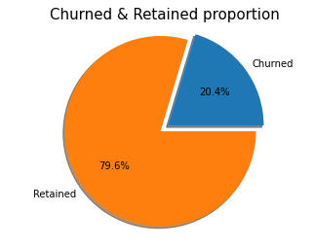
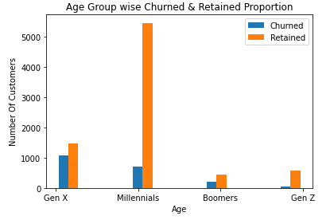

Slide 8
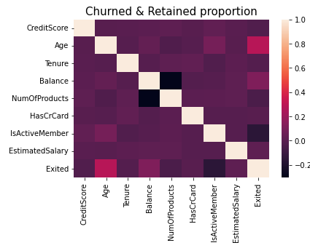
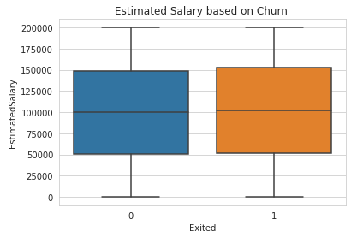

Slide 9
Label Encoding
Label Encoding of Gender Column:
Before Encoding: ['Female' 'Male']
After Encoding: [0 1]
Label Encoding of Geography Column:
Before Encoding: ['France' 'Spain' 'Germany']
After Encoding: [0 2 1]
Label Encoding of AgeGroup Column:
Before Encoding: ['Gen X' 'Millennials' 'Gen Z' 'Boomers']
After Encoding: [1 3 2 0]

Slide 10
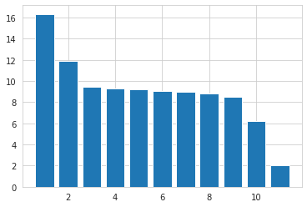
Dimensionality Reduction & Variable Selection
Principal Component Analysis is used for reducing dimensionality and removing principal component.
First 10 columns are selected for model building and prediction
Last customized column is excluded for having lower variance
Variance Proportion for PCA

Slide 11
Data Partitioning
Using train_test_split of sklearn.model_selection library the data is splitted into 2 parts
Training Data Size : 70%
Testing Data Size : 30%

Slide 12
Data Mining Models
Following Supervised Machine Learning models are used to classify the data:
Logistic Regression Classifier
K Nearest Neighbour Classifier
Random Forest Classifier

Slide 13
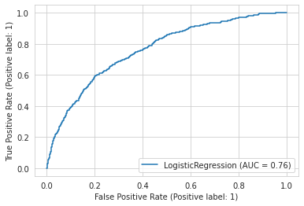
Model Performance Evaluation
1. Logistic Regression Classifier:
Confusion Matrix: [[2581 76]
[ 529 114]]
Model Score(Accuracy): 81.67 %
Recall: 0.57
Precision: 0.72

Slide 14
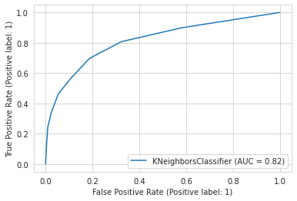
Model Performance Evaluation
2. K Nearest Neighbour Classifier:
Confusion Matrix: [[2642 15]
[ 536 107]]
Model Score(Accuracy): 83.3 %
Recall: 0.58
Precision: 0.85

Slide 15
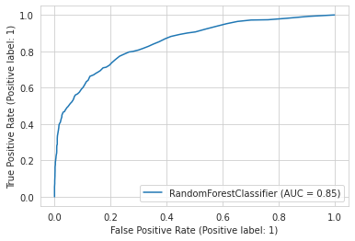
Model Performance Evaluation
3. Random Forest Classifier:
Confusion Matrix: [[2557 100]
[ 342 301]]
Model Score(Accuracy): 86.61 %
Recall: 0.71
Precision: 0.81

Slide 16
Overall Models Evaluation
 | Accuracy | Recall | Precision
Logistic Regression | 81.67% | 0.57 | 0.71
K Nearest Neighbour | 83.30% | 0.58 | 0.85
Random Forest Classifier | 86.61% | 0.71 | 0.81

Slide 17
Insights for Decision Making
Age and balance are two factors that contribute to customer churn
Customers under the age of 25 have the highest rate of churn, followed by customers of increasing age
The rate of churn is proportional to age
Customers aged 25 to 40 have the highest rate of retention

Slide 18
Thank you
Ashok THIRUVENGADAM
MUKUND BANKAR

